Slide 1
Philip Nelson
Stone Porch Consulting
github.com/panmanphil
twitter.com/panmanphil
panmanphil.wordpress.com
Docker and Containerized apps

Slide 2



agenda
What is Docker
Why should I run this on my box? Does this work?
Ask your questions, I’ll try to live code
So it’s really that great?

Slide 3


Docker is like a zip file
Stuff a piece of software in there and you’re good to go

Slide 4

Docker is like a zip file
Stuff a piece of software in there and you’re good to go
docker run –d tasty-app

Slide 5
Running a program in a zip file
Add the program to the zip….
Wait, what?

Slide 6
Running a program in a zip file
In docker:
The zip file is an image
When you run an program in an image, you are creating a container

Slide 7
Running a program in a zip file
Stuffing a program in the zip =
docker build –t tasty-image .

Slide 8

Running a program in a docker image
docker run tasty-image
Uhhh … there’s more to it than that

Slide 9
Building with Dockerfiles
The minimal base set of files
FROM microsoft/nanoserver
ADD ./bin/debug/netcoreapp2.0/* ./
Source file(s)
Destination inside the image

Slide 10
Running a program in a docker image
docker run tasty-image dotnet tasty-app.dll
Do I really have to type all that?

Slide 11
Building with Dockerfiles
FROM microsoft/dotnet
ADD ./bin/debug/netcoreapp2.0/* ./
CMD [“dotnet”, “tasty-app.dll”]
Adds a default command to run when a container starts

Slide 12
Building with Dockerfiles
FROM microsoft/<base image with most of what you need>
# all your build commands including pulling real zip files from remote sites, running commands
# the default command to run
CMD [“dotnet”, “tasty-app.dll”]

Slide 13
Running a container from a docker image
docker run tasty-image

Slide 14
Building with Dockerfiles
FROM Microsoft/dotnet
….
# run a command in the container during the build
RUN delete *.txt
# the default command to run
CMD [“dotnet”, “tasty-app.dll”]

Slide 15
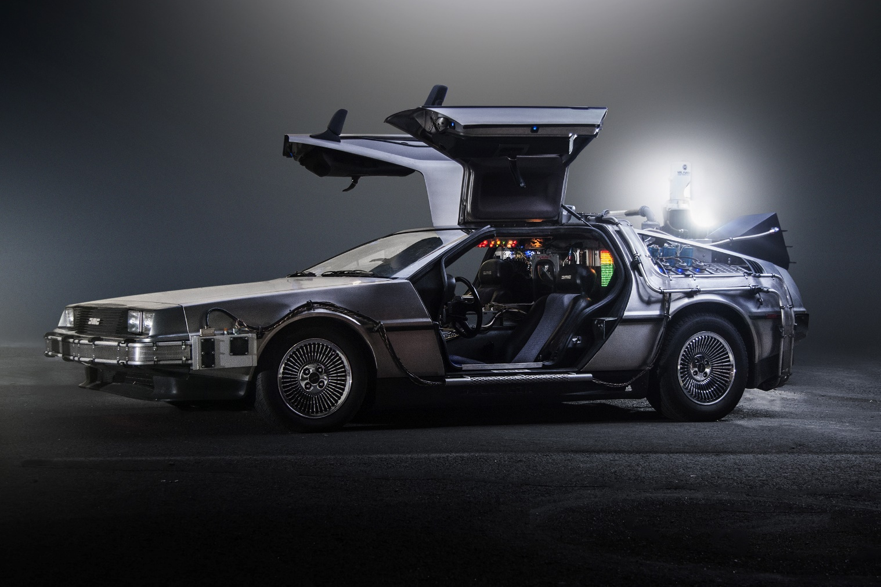
Our perfect developer box
We build the box, we install to it and life is good

Slide 16
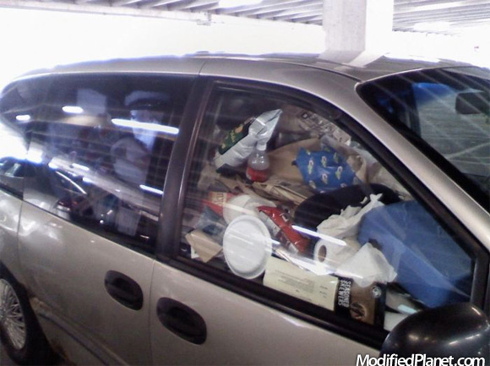
+ 1 year

Slide 17
Containers vs installs
Your host system remains much cleaner
Apps running natively use the kernel, the filesystem, memory and cpu like any other software
Multiple versions of the same software are not a problem
Unless you share files with volumes, removing the containers and image deletes everything from your system

Slide 18
Containers vs installs (legacy)
Windows server core, .i.e full windows containers are really big!
Apps do not run natively so can’t use the kernel, the filesystem, memory and cpu like any other software
Slower startup time
Sharing files with the host can be more awkward. No network drives, uses smb file sharing
Ports map correctly but you can’t access from localhost!!! Use ip from docker inspect and internal port

Slide 19
Containers vs installs (win v lin)
Many more examples and prebuilt images for linux
Some linux standard features don’t work on windows
FROM scratch
docker cp (copy files to or from live container)
volume mapping can get interesting
can’t volume map a single file (ex: web.config)
Because windows software typically doesn’t log to console, docker logs statements often don’t help

Slide 20
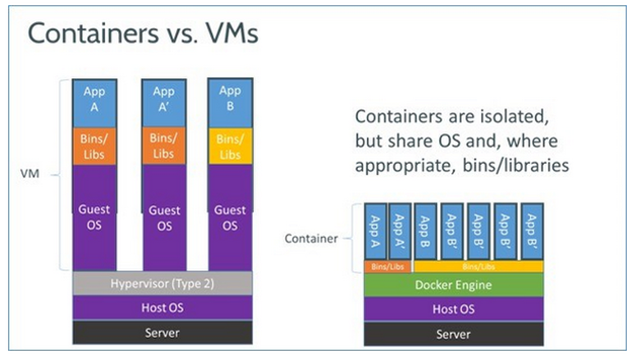

Slide 21
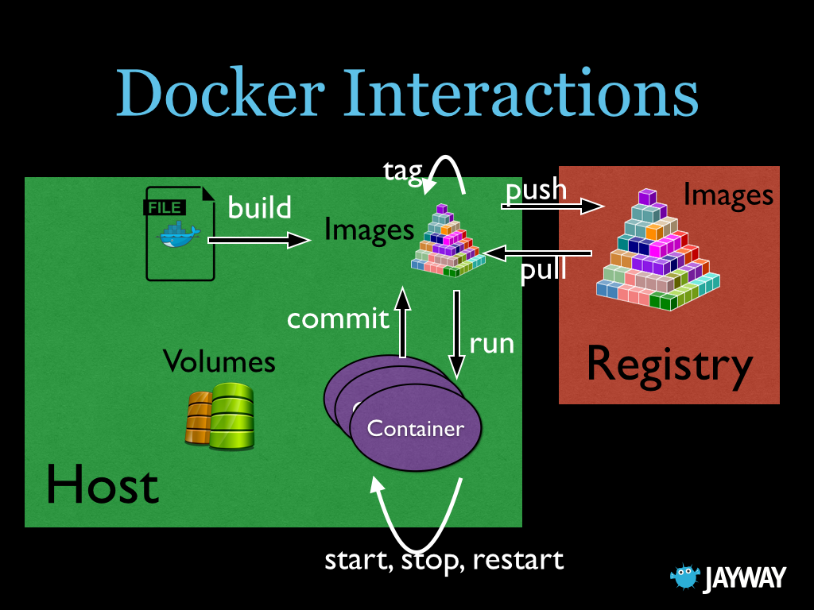
Containers
Software installed servers (guests), fully automated network setup, automated OS setup, automated application setup, automated deployments, slice up VM into smaller units
Each unit appears to the application as owning it’s own OS
In reality, all units share the same kernel

Slide 22
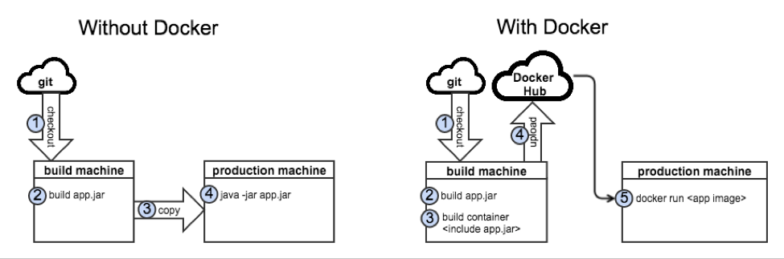
Containers - Building

Slide 23
Containers - Running
You run with an image:
docker run –d yourregistryname/yourimage
Map ports to the host ports
docker run –d someimage –p 80:8080
Use volumes to persist data between different versions of the image
docker run –d someimage –v /var/run/mysql:/home/ec2user/mysql

Slide 24
Containers - Demo
Run Mongodb server and command line tools without installing software
.net Core app from Windows

Slide 25
Containers – Run
Example:
Node.js container linked to Mongodb from command line
Networking established by container, no need to map external ports
docker run -d --name mongo mongo:latest
docker run -d -p 3000:3000 \
-e MONGODB=mongodb://mongo:27017 \
--name node-starter \
--link mongo

Slide 26
Containers - Volumes
Data will stay with a running container ONLY when it is defined, running or stopped
Demo edit .net core app

Slide 27
Containers - Volumes
Volumes tell docker to manage longer term persistence of data independent of the container
As long as any container references a volume it will remain
Do this with data volumes and –volumes-from option or –v command line
The container must declare a volume or it must be mapped from the command line
Demo mongo data container

Slide 28
Containers - Volumes
For working locally on rapidly changing code, you can map any folder in the container to a host volume
Docker run –d –v /Users/philipnelson/Projects/ThatConference/node-starter:/src …..

Slide 29
Containers - Build
Create a Dockerfile in a folder with all the commands to provision your OS
Base it on top of previously created images to reduce effort and download time
Demo node-starter docker file build
End result is an Image that can be run as a container.

Slide 30
Containers - Registry
After an image is build it can be launched locally.
Or, copy it to a registry like docker hub, and then it can be run from any machine with a connection
docker run –d registryname(dockerhub is default)/imagename
We will focus on local dev here

Slide 31
Containers - Composer
Wire up a number of containers in a file instead of launching manually like we did
Parameters are basically the same
Demo review file and run the system

Slide 32
Containers - Troubleshooting
docker inspect <name> shows the entire configuration of the container
docker logs <name> dumps system logs from within container
docker ps or docker ps –a to see running and not running containers
docker images – lists all of the disk images that make up all your containers
docker exec –t <name> /bin/bash log into a running container

Slide 33
Containers – Good News
Startup speed
Deployment is part of development – build images, run images, setup networking and data
Much easier to prototype with different new technologies
Systems are much easier to establish with different dependencies: versions of infrastructure, legacy considerations, frameworks, languages are all isolated
Scale out is considerably easier (with other tools like ECS, Kubernetes)
Your dev computer doesn’t get buried in unused junk demanding repaves
Operations can focus just on cpu, disk storage, instances, networking boundaries
Dev works connections between containers, logical storage options that will still work on large scale
Everything is scripted, no manual “setup docs” required
Disaster recovery is much much easier to setup

Slide 34
Containers – The Bad News
It is possible to set all this up with script, but it is still operations! Networks, file systems, and especially PERMISSIONS
This is a fast moving space, change is constant, keeping up is an effort
Many of the prebuilt repositories out there are of the “Some guy with a day to hack” variety, not well thought through, just works in all situations
Managing your persistent data is more consistent between applications, but still a major PITA
Some software basically “consumes” and entire host anyway: vagrant/chef/cloudformation may be a better option in these cases except for your dev machne
Understanding where all the logs are is another PITA

Slide 35

Thanks! Philip Nelson github.com/panmanphil twitter.com/panmanphil panmanphil.wordpress.com All versions of this talk at https://github.com/panmanphil/introduction-to-docker

